Slide 1
CONSUMER CREDITWORTHINESS ANALYSIS
A Machine Learning Project- Report

Slide 2
Overview of the Project
Scenario:
It is a machine learning project in the banking domain. It is a banking data which contains information about the status of loan approval. Since bank receives many loans applications on the daily basis. So, the higher management notices that this takes significant amount of time of employees and also since the number of applications for loan approval are also very high that is why they are not able to filter the appropriate candidature for loan approval.
Objective:
The objective of this exercise is to build a machine model, using historical banking data that will help the bank employees to determine appropriate candidature for the loan approval.
Data Dictionary:
Loan_ID: Unique Loan ID issued on every loan for a applicant, dtype: Object.
Gender: Gender of an applicant whether male or female, dtype: string.
Married: Martial status of an applicant i.e., Yes for married and NO for single, dtype: string.
Dependents: Number of individuals who are financially dependent on applicant, dtype: integer.
Education: Highest Education of applicant i.e, Bachelor, Post Graduation etc, dtype: string.
Self_employed: Whether the applicant is self-employed or not i.e., Yes for self-employed or else NO, dtype: string.
ApplicantIncome: Income of the applicant, dtype: integer.
CoApplicantIncome: Applicant have to put one nominee name that is called CoApplicant. So, it is column releated to coapplicant income, dtype: Integer.
Loan Amount: Amount of loan applicant wants to issue from the bank.
Loan_Amount_Term: The amount of time the lender gives you to repay your whole loan, dtype: float.
Credit_History: It tells about the credit done in the past by the applicant, dtype: Integer.
Property_Area: This tells about the applicant property is in which area i.e., Rural or Urban, dtype: String.
Loan_status: It is a target variable column which tells about whether the applicant application for loan approval is passed or not, dtype: String.

Slide 3
Milestone 1
Business Understanding Phase

Slide 4
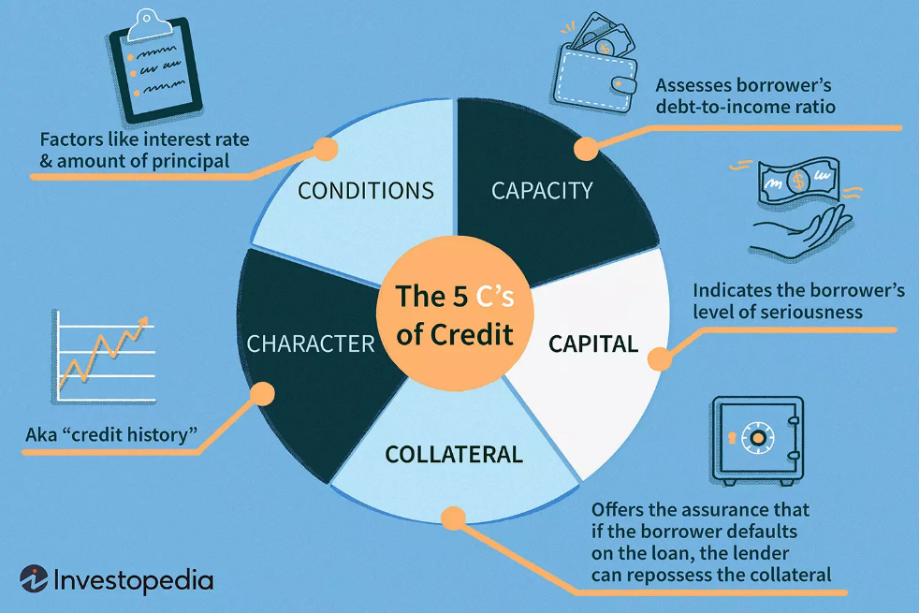
Suggest the probable business impact of each independent feature on the target.
5C’s of Credit

Slide 5
Independent features | Supporting Hypothesis | Business Impact
Loan ID | This is a unique ID for the purpose of identification of customer. | Low
Gender | The gender of customer should not be a factor in determining the credit worthiness of a customer. Especially in today’s scenario where in each sector there is equal contribution. | Low
Married | The marital status of a consumer can contribute towards the increase in expenditure or responsibilities of a person which in turn can impact how easily a person can fulfil his/her financial liabilities. | Medium
Dependents | Higher number of dependents on a consumer reflects increased financial burden of a consumer which directly impacts his loan repayment easiness. | High
Education | The level of education or skill acquired can impact the creditworthiness of an applicant, as a more educated person or highly skilled person is more likely to secure higher paying job or wealth creation opportunity for self which in turn means higher chances of successful repayment of loan amount. | High
Self employed | The section of consumers who are self-employed are more vulnerable to be affected by changes in market conditions or rise in inflation especially in situations like COVID-19 as compared to a salaried person. So, generally salaried consumers are more safer option than self-employed ones for loans etc. | Medium

Slide 6
Independent features | Supporting Hypothesis | Business Impact
Property Area | The value of property which serves as COLLATERAL, is also an important factor. It offers the assurance that if the borrower gets defaulted, the sum can be recovered by the bank. So, if the property area is Urban OR Rural is likely to indicate if the property has higher or lower value in the market. | High
Loan Amount and Loan Term | These are important terms which determine the CONDITIONS factor of the loan. These should resonate with the Value of the customer(Capacity and Character). | High
Applicant Income | It is major factor reflecting CAPACITY. The income of a person is an important factor for creditworthiness as it reflects the current economic potential of a person which directly reflects the loan amount and term that he/she can bear without getting into trouble. | High
Co-Applicant Income | The coapplicant serves as the security for the bank in case of unsuccessful repayment of loan. It can also be considered as part of COLLATERAL. | High
Credit History | It reflects the Character. It is a borrower’s reputation or track record for repaying debts. This information appears on the borrower’s credit reports. Credit reports contain detailed information about how much an applicant has borrowed in the past and whether they have repaid loans on time.Thus, a good credit history is very much essential for determining the creditworthiness of a customer. | High

Slide 7
2. Suggest ways in which the organisation can benefit as a result of analysing the data.
The organisation will definitely benefit from analysing the data as
It will reduce the chances of giving out bad loans.
It will ensure that worthy customers get approval for the loans which in turn will increase the customer base and also add to the organisation profit making.
Also, it will reduce the chances of biasedness being involved or judgemental errors in sanction of the loans.
And, it will most importantly reduce the time and labour involved in analysing the customer’s creditworthiness.
3. Suggest missing features that can help with the analysis based on business logic.
According to my study, some features which can indicate the CAPITAL factor are missing or in other words, can be helpful in the analysis of creditworthiness of the consumer.
Missing features which can help with the analysis of Creditworthiness are:
Total Income: The total income of the consumer indicates in a better way the resources of credit for them. It can be derived from the given features by summing up the applicant and co-applicant income.
Down-payment (in % of Loan amount): A large capital contribution by the borrower decreases the chance of default. Capital contributions indicate the borrower’s level of investment, which can make lenders more comfortable about extending credit.

Slide 8
c. Cash-flow or Supplemental Income: Sometimes a person can have less Monthly Income or Assets to his/her name but can be a part of some business or valuable entity of his which involves large amount of cash flow or current transactions and can serve as supplemental income. In such case there is a high possibility that such individuals have higher creditworthiness than reflected by looking at only monthly income or assets owned.
d. Debt-to-Credit ratio: The ratio can indicate the extra burden applied in case of loan approval. Its value should not be very big so that the loan gets repaid and the consumer is also able to meet his regular financial needs.
e. Age or Date of Birth: Age of a person is an important factor in determining the economic potential of a customer. A person of older age is more likely to have more financial burdens pertaining to family responsibilities, medical expenses. Also, they have less scope for new wealth-making opportunities. So, age can be an important factor in determining credit worthiness of a consumer.
4. What is the best way to collect data for the suggested features ?
Bank Records: The best way to collect the data for the above features is from the bank records of the customer and also
Transactional History
Third-party agencies or Credit Score Reports
Requisition from customer end for more details: Additional details can be fetched from the customer’s end on request.

Slide 9
Milestone 2
Data Analytics Phase

Slide 10

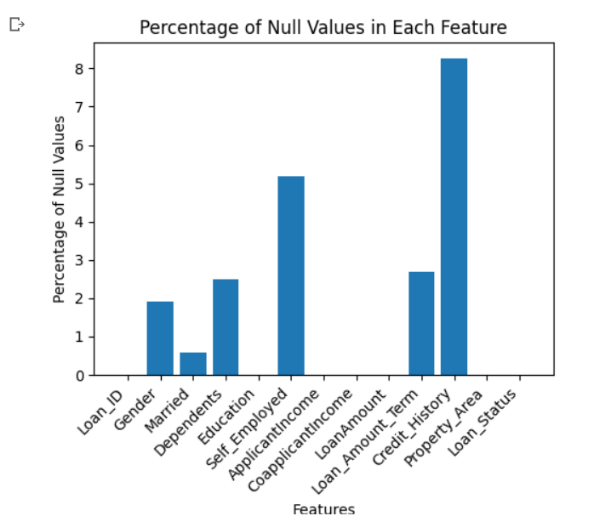
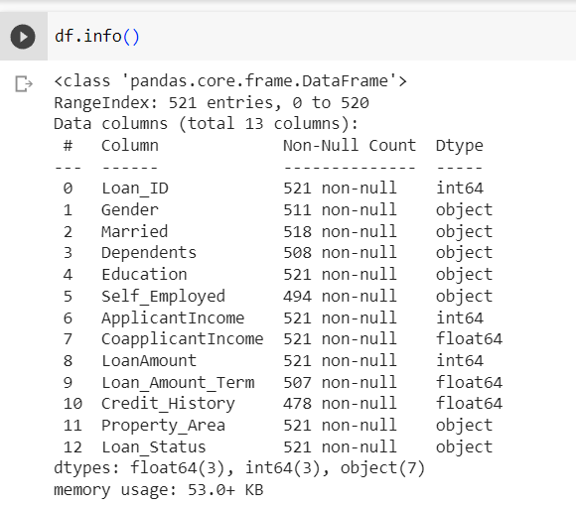
Data Quality Check
The dataset contains 521 rows and 13 features.
Some of the features in the dataset also contains some missing values.
The list of 13 features are as above which provides us the details about the consumers applying for the loans.

Slide 11
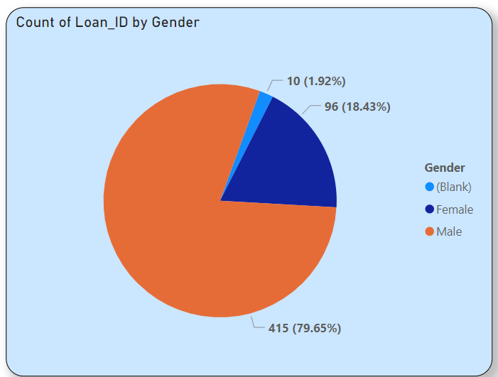
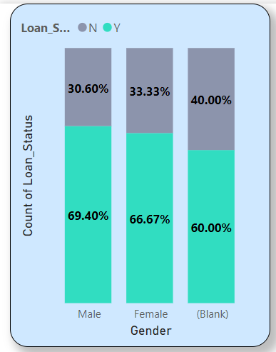
Hypothesis on Impact of different features on the Loan Approval rate
1. Gender
About 80% of the population of the consumers is from male category.
Less than 2% of the data in the gender column is missing or unspecified.
There is not much difference in the loan approval rate between male and female category. Thus, the gender of a consumer has not much impact on the loan approval rate.

Slide 12
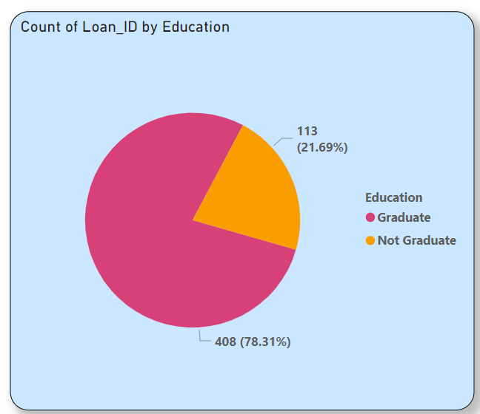
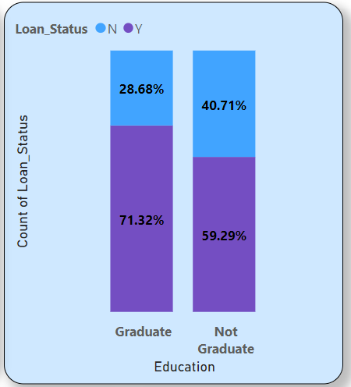
2. Education
Nearly, 78% of the consumers applying for loans are having a graduate degree.
The loan approval rates for persons with graduation is more than non-graduates by nearly 12%. So, level of education is an important feature for loan approval.

Slide 13
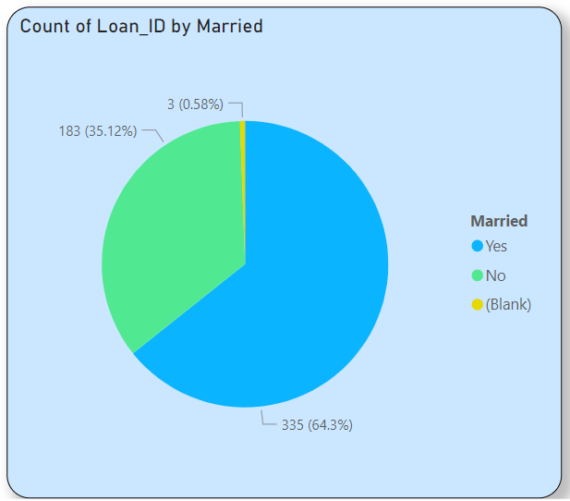
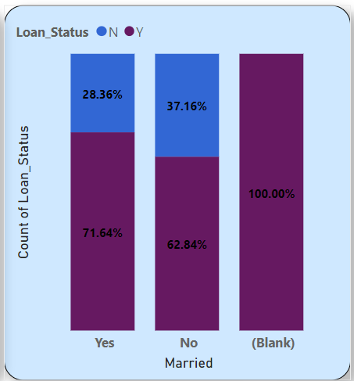
3. Married
More than 60% of the consumers applying for loans are married.
The loan approval rates for married consumers is also slightly better than unmarried ones.
It may be due to the better stability prospect and also some support from partners. Thus, marital status also has some impact on loan approval.

Slide 14
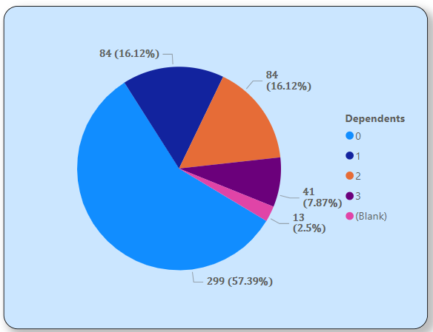
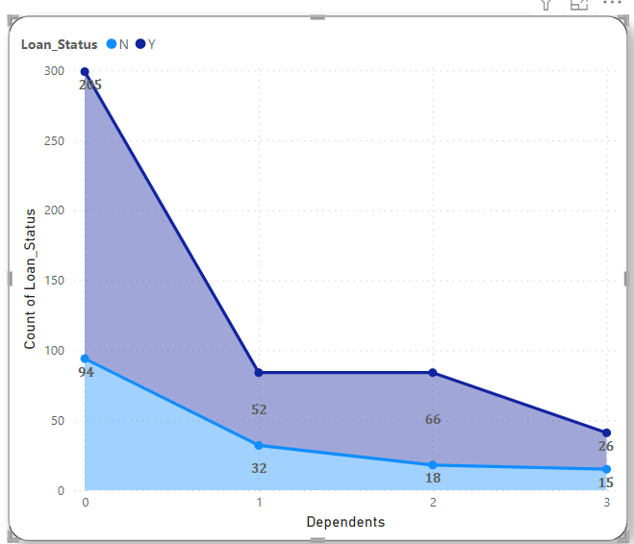
4. Dependents
The persons having 0 dependents have highest percentage of loan approval rates which owes to the fact that less dependents means less financial burden.
Increasing no of dependents has negative impact on loan approval rates, especially when no of dependents goes beyond 2 and above. So, it is an important feature for loan approval.
About 60% of the consumers have no dependents.
Around 15% each are having 1 or 2 dependents.
Only around 7-8% have 3 or more dependents.

Slide 15
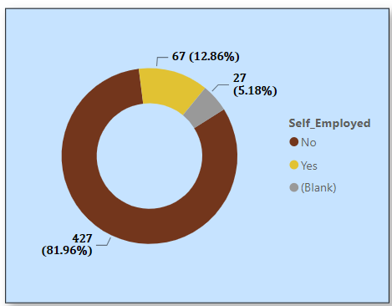
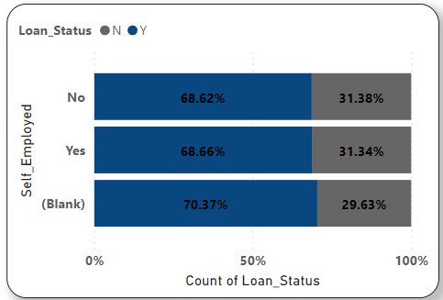
5. Self Employed
Around 80% of the consumers are from the service sector.
Only nearly 13% of the customers are self-employed.
There is not much difference in the loan approval rates based on employment type i.e., self employed or not. So, self-employment doesn’t have much impact on loan approval rates on its own.

Slide 16
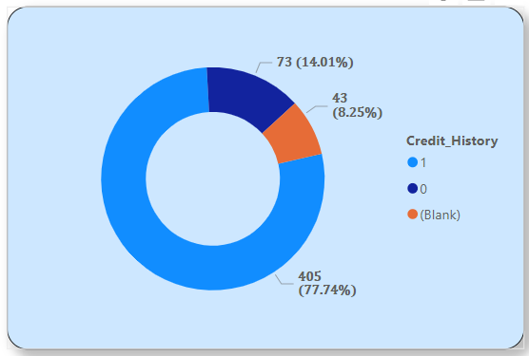
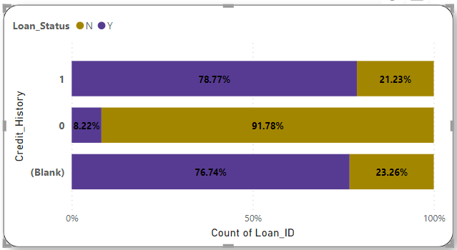
6. Credit History
Around 78% of the consumers are having good credit history. Rest of them have either bad or unknown credit history.
The loan approval rates for consumers with good credit history is quite high around 79%.
People having bad credit history have very less chances of loan approval, only 8%.
Also, people whose credit history is not available have good chances around 76% of loan approval. It may indicate the fact that majority of them will be new customers applying for loans for first time.
Thus, credit history is a major factor in loan approval.

Slide 17
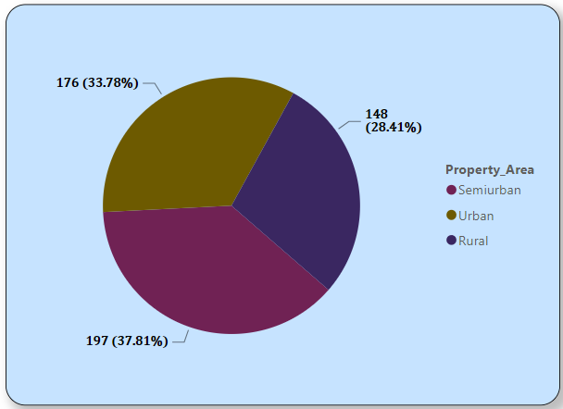
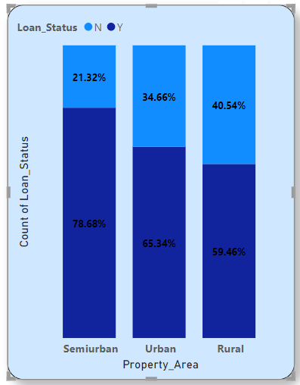
7. Property Area
Majority section of the consumers applying for loans have their properties located in Urban and Semi-urban area.
The properties in Semi-urban area and Urban areas are more valuable as compared to the ones in rural areas.
Hence, the property area is contributing towards improved loan approval rates for Urban and semi-urban category.

Slide 18
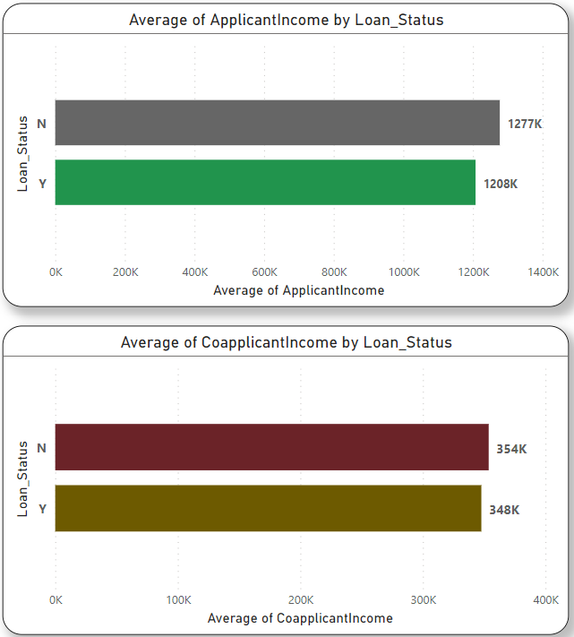
8. Applicant & co-applicant Income
There is not much difference in the average of applicant incomes between approved loans and the rejected ones. So, applicant income solely doesn’t have much impact on the loan approval rate.
There is not much difference in the average of co-applicant incomes between approved loans and the rejected ones. So, co-applicant income solely doesn’t have much impact on the loan approval rate.

Slide 19
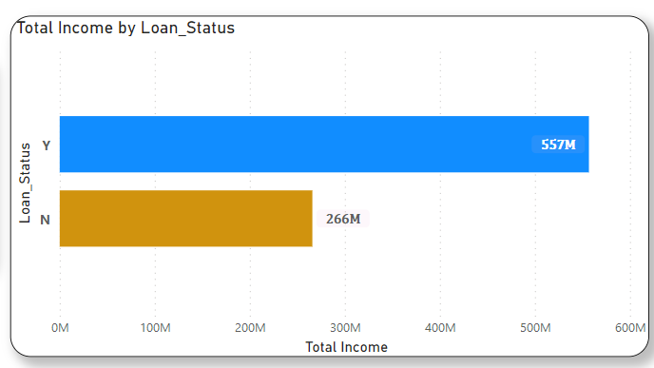
Total Income
Applicant income and co-applicant income in combination is clearly impacting the loan approval rates.
So,
Total income = Applicant Income+co-applicant Income is a much more important feature for loan approval.

Slide 20
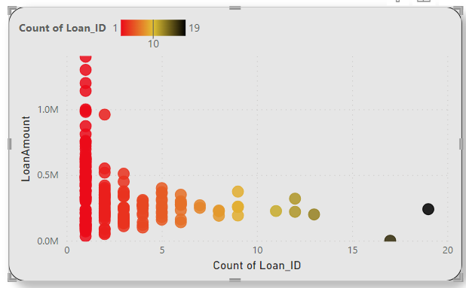
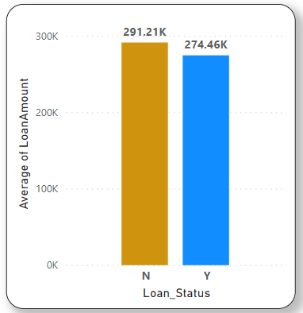
9. Loan Amount
The average of loan amounts which are approved is lower than the ones getting rejected.
This indicates that the loan amount should be reasonable and not very high.
The majority of the loan amounts applied are for a sum of under 5 lakhs .

Slide 21

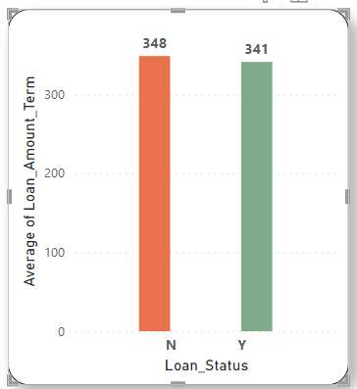
10. Loan Amount Term
The majority of the Loan_Amount_Term applied is for a term of 360.
The terms of 180, 480 and 300 forms the next major chunk of applications.
The average of loan_amount_term which are approved is around 340.
This indicates that the loan_amount_term of shorter durations are more preferable for loan approvals.

Slide 22
Insights from the Data with supporting hypothesis
Independent Features | Hypothesis from Market Research | Hypothesis from Data insights | Business Impact
Loan ID | This is a unique ID for the purpose of identification of customer. | -Same- | None
Gender | The gender of customer should not be a factor in determining the credit worthiness of a customer. Especially in today’s scenario when there is schemes and policies for bringing equality. | There is not much difference in the loan approval rate between male and female category. Thus, the gender of a consumer has not much impact on the loan approval rate. | Low
Married | The marital status of a consumer can contribute towards the increase in expenditure or responsibilities of a person which in turn can impact how easily a person can fulfil his/her financial liabilities. | The loan approval rate is slightly better for married ones, it may be due to the better stability prospect or also getting some support from partners. Thus, marital status also has some impact on loan approval. | Medium
Dependents | Higher number of dependents on a consumer reflects increased financial burden of a consumer which directly impacts his loan repayment easiness. | Increasing no of dependents has negative impact on loan approval rates, especially when no of dependents goes beyond 2 and above. So, it is an important feature for loan approval. | High
Education | The level of education or skill acquired can impact the creditworthiness of an applicant, as a more educated person or highly skilled person is more likely to secure higher paying job or wealth creation opportunity for self which in turn means higher chances of successful repayment of loan amount. | The loan approval rates for persons with graduation is more than non-graduates by nearly 12%. So, level of education is an important feature for loan approval. | High
Self employed | The section of consumers who are self-employed are more vulnerable to be affected by changes in market conditions or rise in inflation especially in situations like COVID-19 as compared to a salaried person. So, generally salaried consumers are more safer option than self-employed ones for loans etc. | There is not much difference in the loan approval rates based on employment type i.e., self employed or not. So, self-employment doesn’t have much impact on loan approval rates on its own. | Medium

Slide 23
Insights from the Data with supporting hypothesis
Independent Features | Hypothesis from Market Research | Hypothesis from Data insights | Business Impact
Applicant Income & Co-applicant Income | It is a major factor reflecting CAPACITY. The income of a person is an important factor for creditworthiness as it reflects the current economic potential of a person which directly reflects the loan amount and term that he/she can bear without getting into trouble. The co-applicant serves as the security for the bank in case of unsuccessful repayment of loan. It can also be considered as part of COLLATERAL. | For both the applicant income & co-applicant income. There is not much difference in the average between approved loans and the rejected ones. So, applicant they solely doesn’t have much impact on the loan approval rate. But, Total income = Applicant Income+co-applicant Income is an important feature for loan approval. | Medium
Credit History | It reflects the Character. It is a borrower’s reputation or track record for repaying debts. This information appears on the borrower’s credit reports. Credit reports contain detailed information about how much an applicant has borrowed in the past and whether they have repaid loans on time. Thus, a good credit history is very much essential for determining the creditworthiness of a customer. | The loan approval rates for consumers with good credit history is quite high around 79%. People having bad credit history have very less chances of loan approval, only 8%. Also, people whose credit history is not available have good chances around 76% of loan approval. It may indicate the fact that majority of them will be new customers applying for loans for first time. Thus, credit history is a major factor in loan approval. | High
Property Area | The value of property which serves as COLLATERAL, is also an important factor. It offers the assurance that if the borrower gets defaulted, the sum can be recovered by the bank. So, higher valued property will be more preferred for loan approval. | The properties in Semi-urban area and Urban areas are more valuable as compared to the ones in rural areas. Hence, the property area is contributing towards improved loan approval rates for Urban and semi-urban category. | High
Loan Amount and Loan Term | These are important terms which determine the CONDITIONS factor of the loan. These should resonate with the Value of the customer(Capacity and Character). | The loan amount should be reasonable and not very high. The loan amount term of shorter durations are more preferable for loan approvals. | High

Slide 24
Milestone 3
Data Pre-processing and Feature Engineering

Slide 25
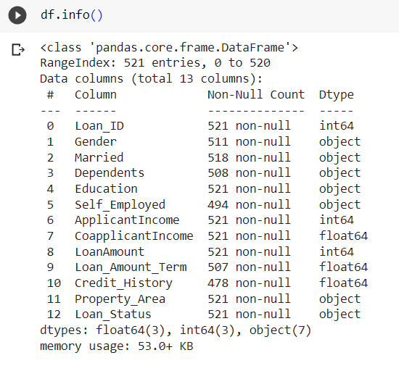
Data Pre-processing
The given dataset looks like this:
1. ‘Loan_ID’ is a identification feature so it is not required for analysis. So, this feature will be dropped before modelling.

Slide 26
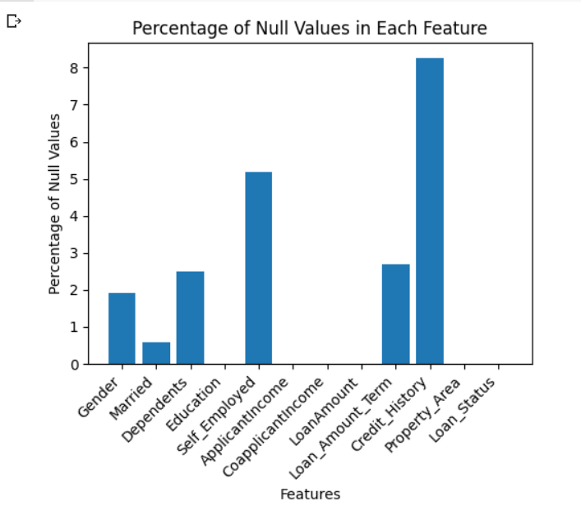
Missing Value Treatment
Dependents, Loan Amount term, Self Employed & Credit history columns have more than 2% of missing columns, so we need to impute the missing values as removing these rows will cause a loss of lot of information.
Gender & Married columns are having less than 2% of missing values, so we will be removing the rows containing the missing values.

Slide 27
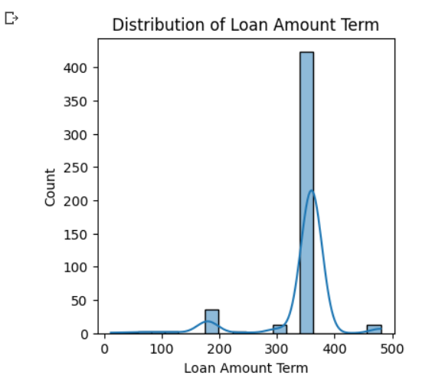
Loan Amount term is the only numerical feature containing missing values, and the data is skewed towards higher term.
So, we will impute the missing values with median value of the distribution.

Slide 28
Feature creation
Total Income : - After analysing the data and effect of each of the features with the target variable, we observed that Applicant Income and Co-applicant income in combination is more important for the loan approval.
So, a derived feature named Total Income has been added which is the sum of Applicant Income and Co-applicant Income .
Debt to Credit ratio : - The ratio of Loan amount to the Total income has been calculated as a new feature called Debt to Credit ratio, based on business understanding.

Slide 29
Feature Selection
After data preprocessing and feature engineering, wherein we checked that all features going forward for modelling are independent and important for the target variable, only the important features influencing the target variable are selected as inputs for the model.
Some of the important modifications done with the features before feature selection is carried out are:
Total Income was added as a feature and Applicant Income & Co-applicant Income were dropped as these were highly correlated features.
The data distribution of Total income was highly skewed on the lower side, so log transformation which both improves the data skewness and also scale the features was carried out.

Slide 30
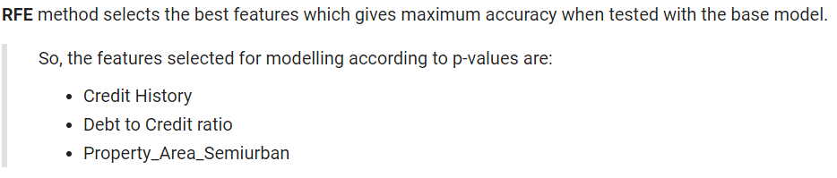
Feature Selection - algorithms
Multiple methods were used for selecting the most important features having high influence on our target variable.
SelectKBest()
RandomForestClassifier
RFE(Recursive Feature Elimination)
And, subsequently the features selected according to each method were tested on a prototype model of Logistic regression, as it is one of the best algorithms for classification modelling.
The method whose set of features performed best according to the evaluation metrics was finally used for feature selection.

Slide 31
Milestone 4
Classification Modelling

Slide 32
Classification Models
Logistic Regression
KNN Classifier
Random Forest Classifier
XGBoost Classifier
Naïve-Bayes Classifier
SVM
Deep Learning Model using Neutral Network

Slide 33
Evaluation Metrics
Accuracy : This is a basic metric that calculates the ratio of correct predictions to the total number of predictions
Precision : Precision measures the ratio of true positive predictions to the total number of positive predictions (both true positives and false positives). In the context of credit risk analysis, precision helps assess how many of the predicted defaults were actually correct.
F1-score : The F1-score is the harmonic mean of precision and recall. It balances both metrics and can be useful when you want to consider both false positives and false negatives.
Area under ROC curve : The ROC curve is a plot of the true positive rate (recall) against the false positive rate at various thresholds. AUC-ROC measures the overall performance of the model across different thresholds. It's useful when you want to assess the model's ability to distinguish between positive and negative cases, regardless of the chosen threshold.

Slide 34
Classification Model | Performance
Logistic Regression | Accuracy – 0.79 Precision – 0.88 F1 score – 0.74 AUC-ROC – 0.74
KNN Classifier | Accuracy – 0.80 Precision – 0.88 F1 score – 0.75 AUC-ROC – 0.75
Random Forest Classifier | Accuracy – 0.80 Precision – 0.83 F1 score – 0.77 AUC-ROC – 0.76
XGBoost Classifier | Accuracy – 0.80 Precision – 0.88 F1 score – 0.75 AUC-ROC – 0.78
Naïve-Bayes Classifier | Accuracy – 0.80 Precision – 0.88 F1 score – 0.75 AUC-ROC – 0.77
SVM | Accuracy – 0.79 Precision – 0.88 F1 score – 0.74 AUC-ROC – 0.74
Neural Network | Accuracy – 0.80 Precision – 0.88 F1 score – 0.75 AUC-ROC – 0.74

Slide 35
Hyperparameter Tuning – XGBoost Model
XGBoost Classifier is the best performing with the selected features and given data set.
Now, we will try to improve the performance of model using hyperparameter tuning.
We are using ‘GridSearchCV’ function under ‘scikit-learn’ library : It is used for hyperparameter tuning, which involves finding the best set of hyperparameters for a machine learning model to achieve the best performance on a given task.
Some of the important hyperparameters include:
learning_rate (Default: 0.3): The learning rate controls the step size at each iteration while moving towards a minimum of the loss function. Lower values make the training process more robust but slower.
n_estimators(default:100) :The number of boosting rounds or trees to build. Increasing this value can lead to a more complex model, but be cautious about overfitting.
max_depth (default: 6) : The maximum depth of a tree. Higher values can lead to more complex trees, which may capture fine-grained patterns but can also lead to overfitting.
min_child_weight(default: 1) : The minimum sum of instance weight (hessian) needed in a child node. It can be used to control over-fitting. Higher values prevent splitting child nodes with low weights, effectively introducing regularization.
gamma (default: 0) : The minimum loss reduction required to make a further partition on a leaf node. It acts as a regularization parameter, and higher values encourage more conservative splits.
Lambda(default: 1) : L2 regularization term on weights. It's also known as the "L2 penalty" or "ridge regression." It helps control overfitting by discouraging large weights.
Alpha(default: 0) :L1 regularization term on weights. It's also known as the "L1 penalty" or "Lasso regression." Like lambda, it helps control overfitting by encouraging sparse feature importance.

Slide 36
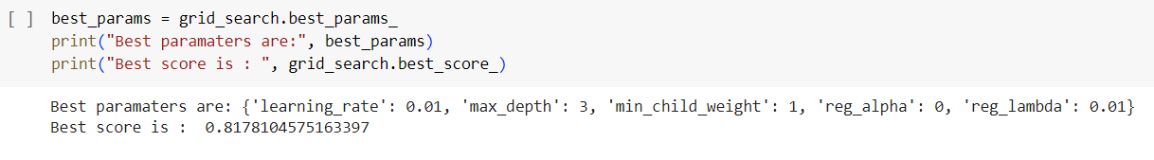
The set of best parameters for the XGBoost Model, giving an accuracy of 0.81.

Slide 37
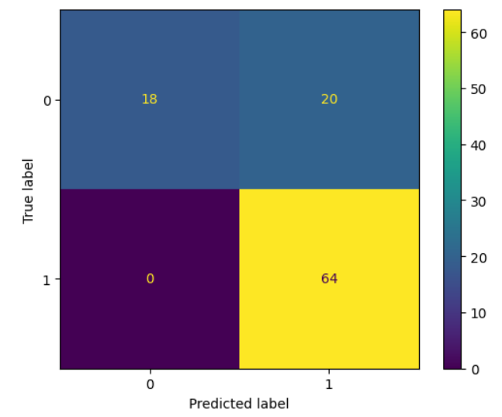
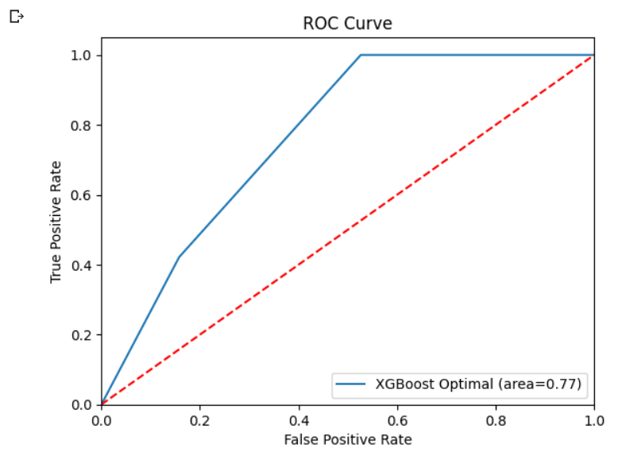
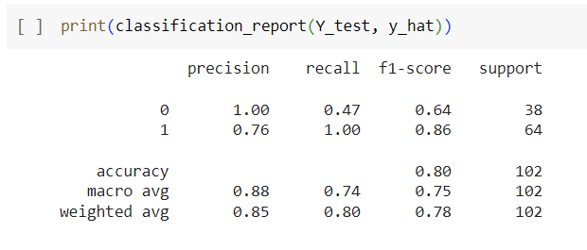
Result
Implementing the best model on the test dataset

